Slide 1
CS 179: Lecture 13
Intro to Machine Learning

Slide 2
Goals of Weeks 5-6
What is machine learning (ML) and when is it useful?
Intro to major techniques and applications
Give examples
How can CUDA help?
Departure from usual pattern: we will give the application first, and the CUDA later

Slide 3
How to Follow This Lecture
This lecture and the next one will have a lot of math!
Don’t worry about keeping up with the derivations 100%
Important equations will be boxed
Key terms to understand: loss/objective function, linear regression, gradient descent, linear classifier
The theory lectures will probably be boring for those of you who have done some machine learning (CS156/155) already

Slide 4
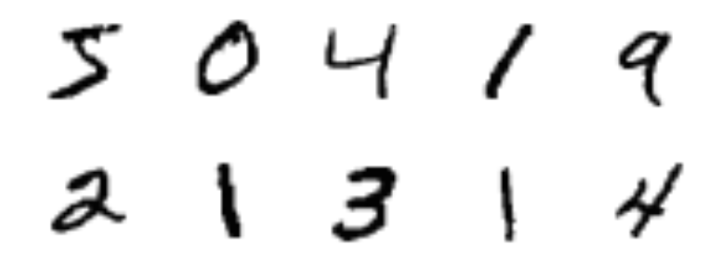

What is ML good for?
Handwriting recognition
Spam detection

Slide 5
What is ML good for?
Teaching a robot how to do a backflip
https://youtu.be/fRj34o4hN4I
Predicting the performance of a stock portfolio
The list goes on!

Slide 6
What is ML?
What do these problems have in common?
Some pattern we want to learn
No good closed-form model for it
LOTS of data
What can we do?
Use data to learn a statistical model for the pattern we are interested in

Slide 7
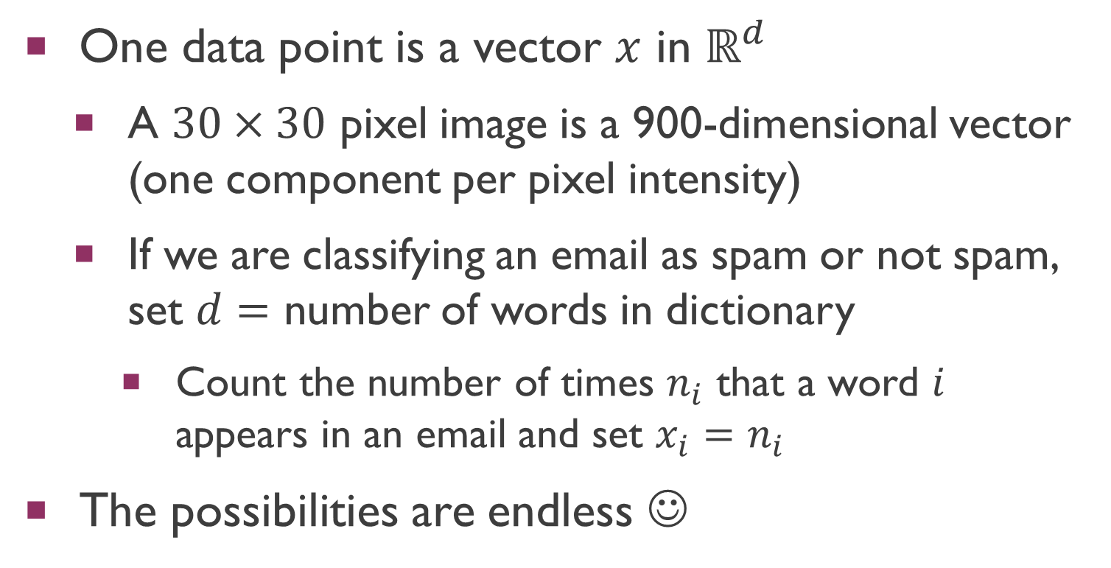
Data Representation
One data point is a vector $x$ in $ℝ^{d}$
A $30×30$ pixel image is a 900-dimensional vector (one component per pixel intensity)
If we are classifying an email as spam or not spam, set $d=$ number of words in dictionary
Count the number of times $n_{i}$ that a word $i$ appears in an email and set $x_{i}=n_{i}$
The possibilities are endless ☺
Notes:
Matt Wilson (MIT) – things ML is not good at

Slide 8
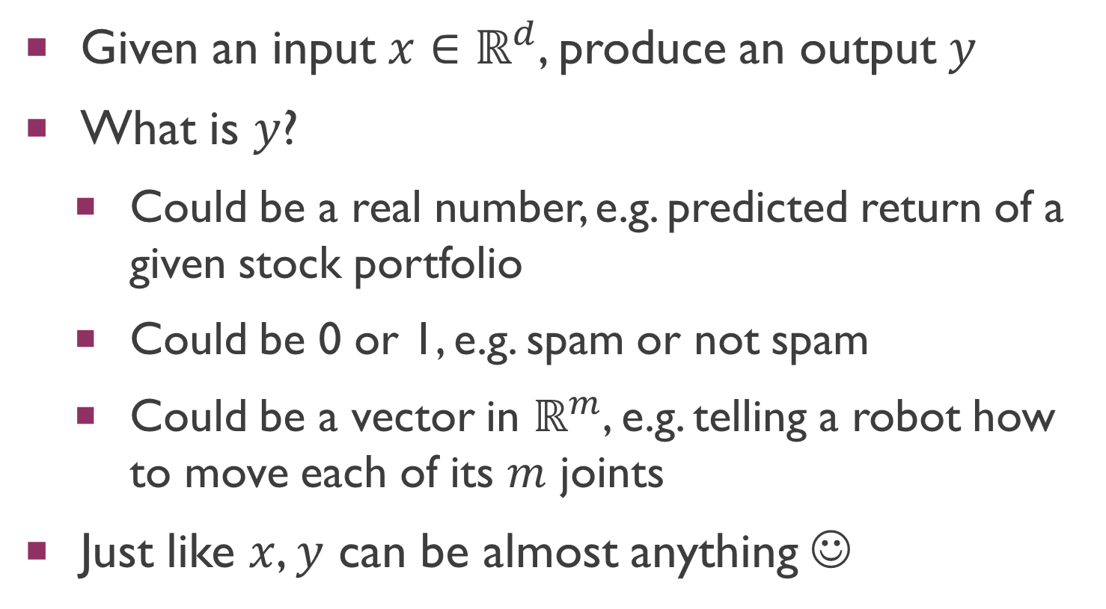
What are we trying to do?
Given an input $x∈ℝ^{d}$, produce an output $y$
What is $y$?
Could be a real number, e.g. predicted return of a given stock portfolio
Could be 0 or 1, e.g. spam or not spam
Could be a vector in $ℝ^{m}$, e.g. telling a robot how to move each of its $m$ joints
Just like $x$, $y$ can be almost anything ☺

Slide 9
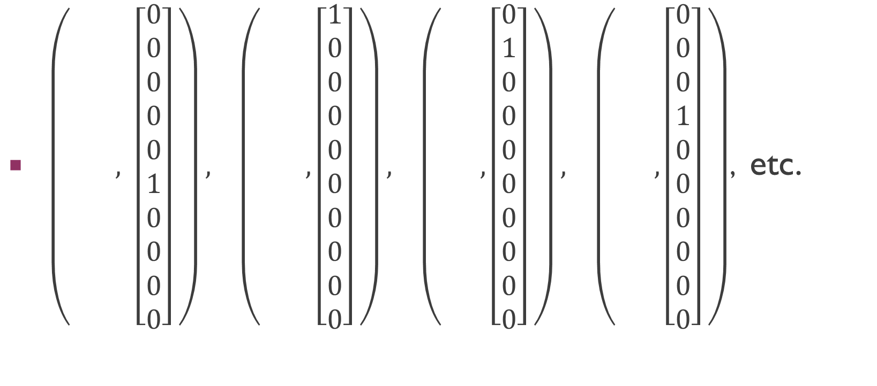

Example of $(x, y)$ Pairs
$\left( , \left[\begin{aligned}0 \\ 0 \\ 0 \\ 0 \\ 0 \\ 1 \\ 0 \\ 0 \\ 0 \\ 0\end{aligned}\right] \right), \left( ,\left[\begin{aligned}1 \\ 0 \\ 0 \\ 0 \\ 0 \\ 0 \\ 0 \\ 0 \\ 0 \\ 0\end{aligned}\right] \right), \left( ,\left[\begin{aligned}0 \\ 1 \\ 0 \\ 0 \\ 0 \\ 0 \\ 0 \\ 0 \\ 0 \\ 0\end{aligned}\right] \right), \left( ,\left[\begin{aligned}0 \\ 0 \\ 0 \\ 1 \\ 0 \\ 0 \\ 0 \\ 0 \\ 0 \\ 0\end{aligned}\right] \right)$, etc.

Slide 10

Notation
$$x^{′}=\left({1 \atop x}\right)∈ℝ^{d+1}$$
$$X=\left(x^{\left(1\right)},…,x^{\left(N\right)}\right)∈ℝ^{d×N}$$
$$X^{′}=\left({x^{\left(1\right)}}^{′},…,{x^{\left(N\right)}}^{′}\right)∈ℝ^{\left(d+1\right)×N}$$
$$Y={\left(y^{\left(1\right)},…,y^{\left(N\right)}\right)}^{T}∈ℝ^{N×m}$$
$$𝕀\left[p\right]=\left\{\begin{aligned}1 \\ 0\end{aligned}\right. \begin{matrix}p is true \\ otherwise\end{matrix}$$

Slide 11
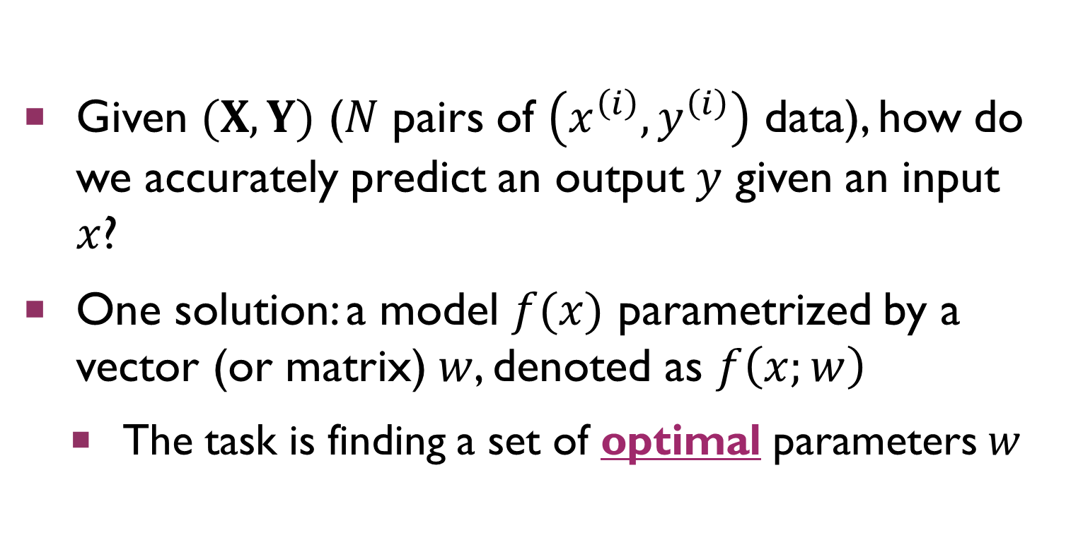
Statistical Models
Given $(X, Y)$ ($N$ pairs of $\left(x^{\left(i\right)}, y^{\left(i\right)}\right)$ data), how do we accurately predict an output $y$ given an input $x$?
One solution: a model $f(x)$ parametrized by a vector (or matrix) $w$, denoted as $f\left(x;w\right)$
The task is finding a set of optimal parameters $w$

Slide 12
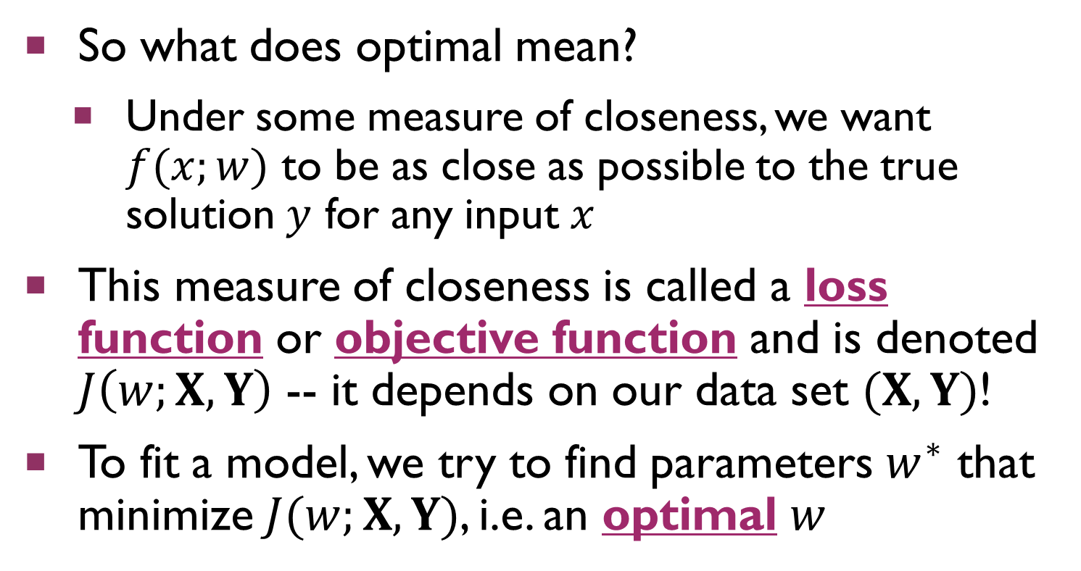
Fitting a Model
So what does optimal mean?
Under some measure of closeness, we want $f(x;w)$ to be as close as possible to the true solution $y$ for any input $x$
This measure of closeness is called a loss function or objective function and is denoted $J\left(w;X,Y\right)$ -- it depends on our data set $(X, Y)$!
To fit a model, we try to find parameters $w^{∗}$ that minimize $J(w;X,Y)$, i.e. an optimal $w$

Slide 13
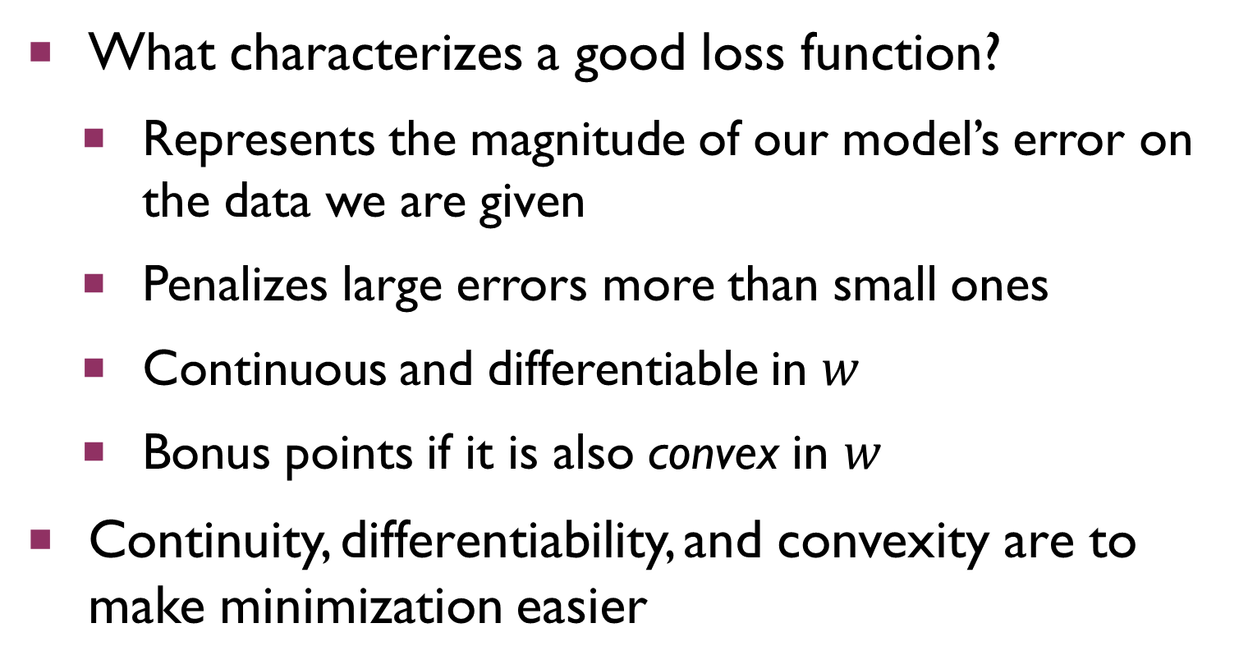
Fitting a Model
What characterizes a good loss function?
Represents the magnitude of our model’s error on the data we are given
Penalizes large errors more than small ones
Continuous and differentiable in $w$
Bonus points if it is also convex in $w$
Continuity, differentiability, and convexity are to make minimization easier

Slide 14
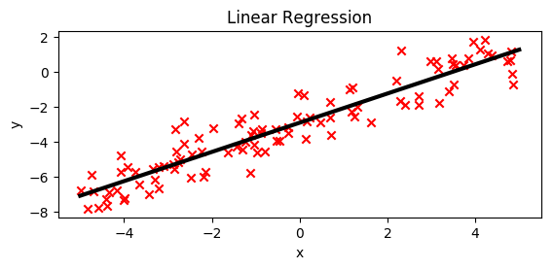
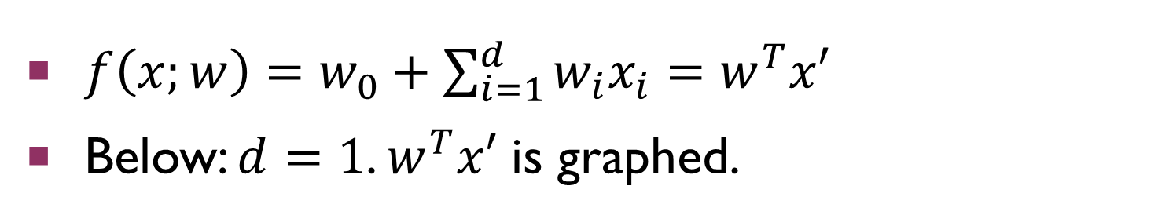
Linear Regression
$f\left(x;w\right)=w_{0}+\sum_{i=1}^{d}{w_{i}x_{i}}=w^{T}x′$
Below: $d=1$. $w^{T}x′$ is graphed.

Slide 15
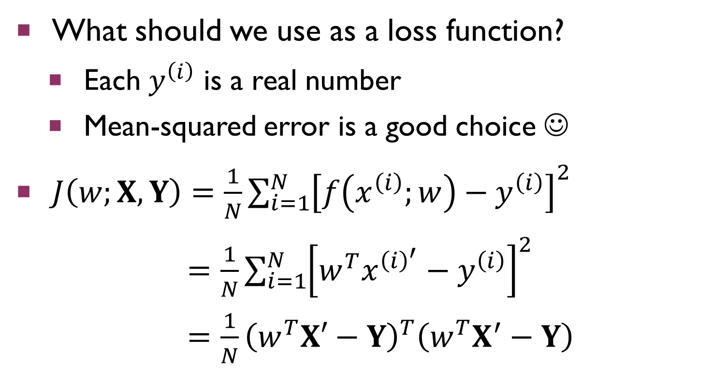
Linear Regression
What should we use as a loss function?
Each $y^{\left(i\right)}$ is a real number
Mean-squared error is a good choice ☺
$J\left(w;X,Y\right)=\frac{1}{N}\sum_{i=1}^{N}{{\left[f\left(x^{\left(i\right)};w\right)−y^{\left(i\right)}\right]}^{2}}$
$=\frac{1}{N}\sum_{i=1}^{N}{{\left[w^{T}x^{{\left(i\right)}^{′}}−y^{\left(i\right)}\right]}^{2}}$
$=\frac{1}{N}{\left(w^{T}X′−Y\right)}^{T}\left(w^{T}X^{′}−Y\right)$

Slide 16
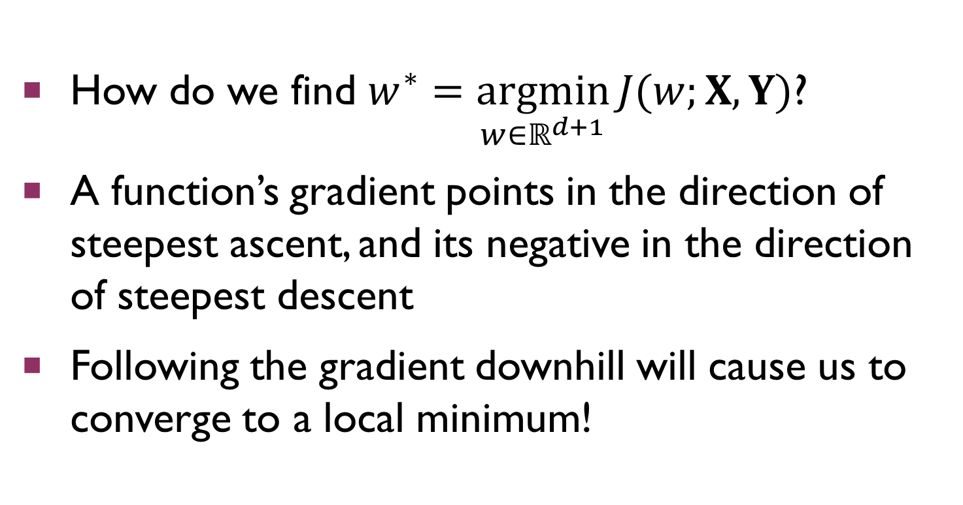
Gradient Descent
How do we find $w^{∗}=\underset{w∈ℝ^{d+1}}{argmin}{J(w;X,Y)}$?
A function’s gradient points in the direction of steepest ascent, and its negative in the direction of steepest descent
Following the gradient downhill will cause us to converge to a local minimum!

Slide 17
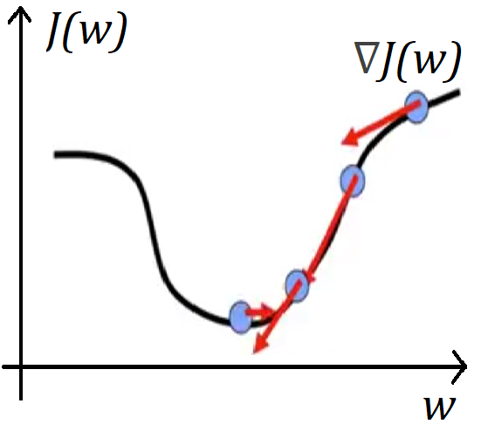
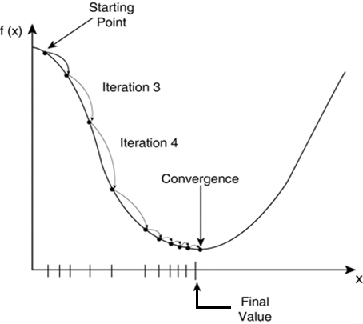
Gradient Descent
Notes:
Distance per step is proportional to the size of the gradient at that step

Slide 18
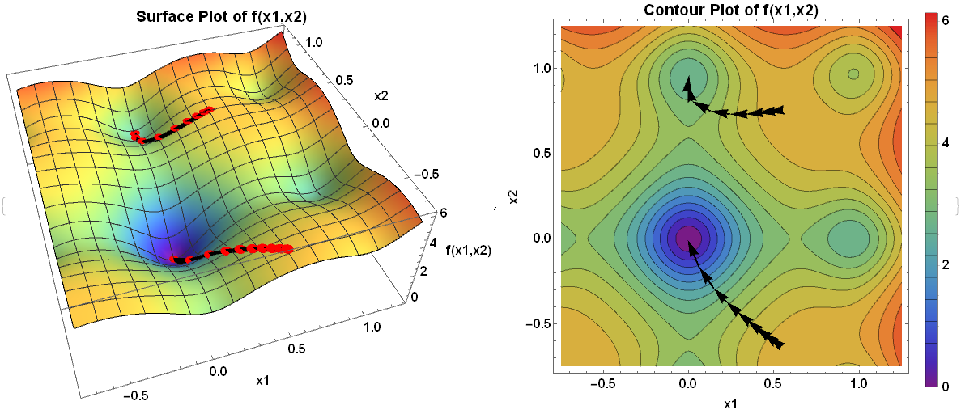
Gradient Descent
Notes:
Note: frequency of contour lines = magnitude of gradient

Slide 19
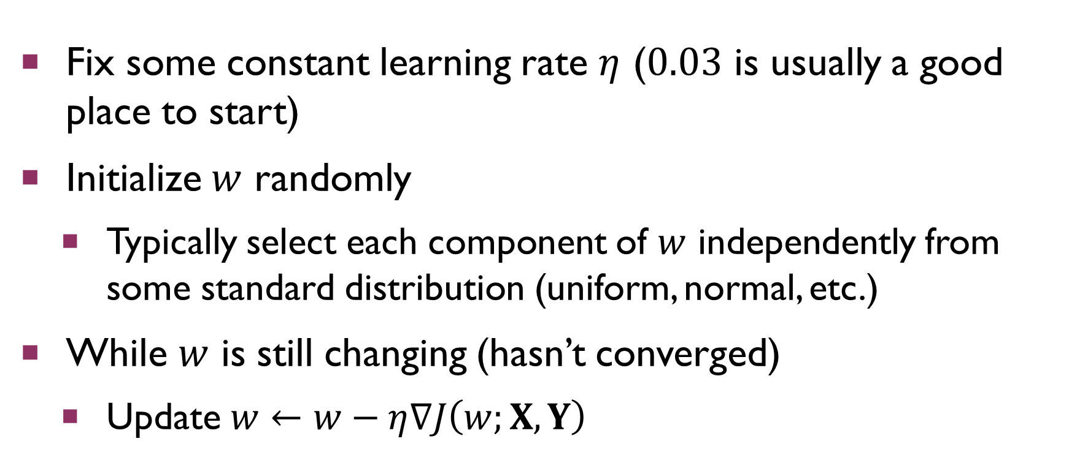
Gradient Descent
Fix some constant learning rate $η$ ($0.03$ is usually a good place to start)
Initialize $w$ randomly
Typically select each component of $w$ independently from some standard distribution (uniform, normal, etc.)
While $w$ is still changing (hasn’t converged)
Update $w←w−η∇J\left(w;X,Y\right)$

Slide 20
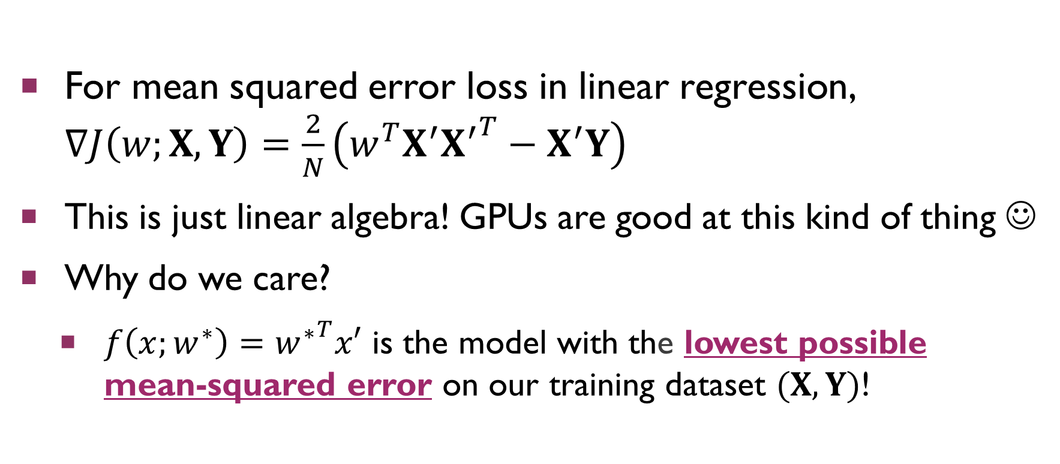
Gradient Descent
For mean squared error loss in linear regression, $∇J\left(w;X,Y\right)=\frac{2}{N}\left(w^{T}X^{′}{X^{′}}^{T}−X^{′}Y\right)$
This is just linear algebra! GPUs are good at this kind of thing ☺
Why do we care?
$f\left(x;w^{∗}\right)={w^{∗}}^{T}x′$ is the model with the lowest possible mean-squared error on our training dataset $(X, Y)$!

Slide 21
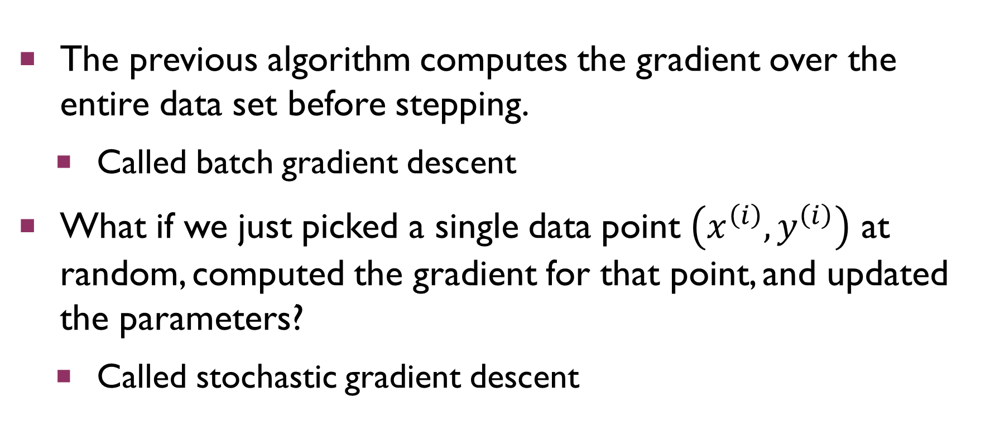
Stochastic Gradient Descent
The previous algorithm computes the gradient over the entire data set before stepping.
Called batch gradient descent
What if we just picked a single data point $\left(x^{\left(i\right)}, y^{\left(i\right)}\right)$ at random, computed the gradient for that point, and updated the parameters?
Called stochastic gradient descent

Slide 22
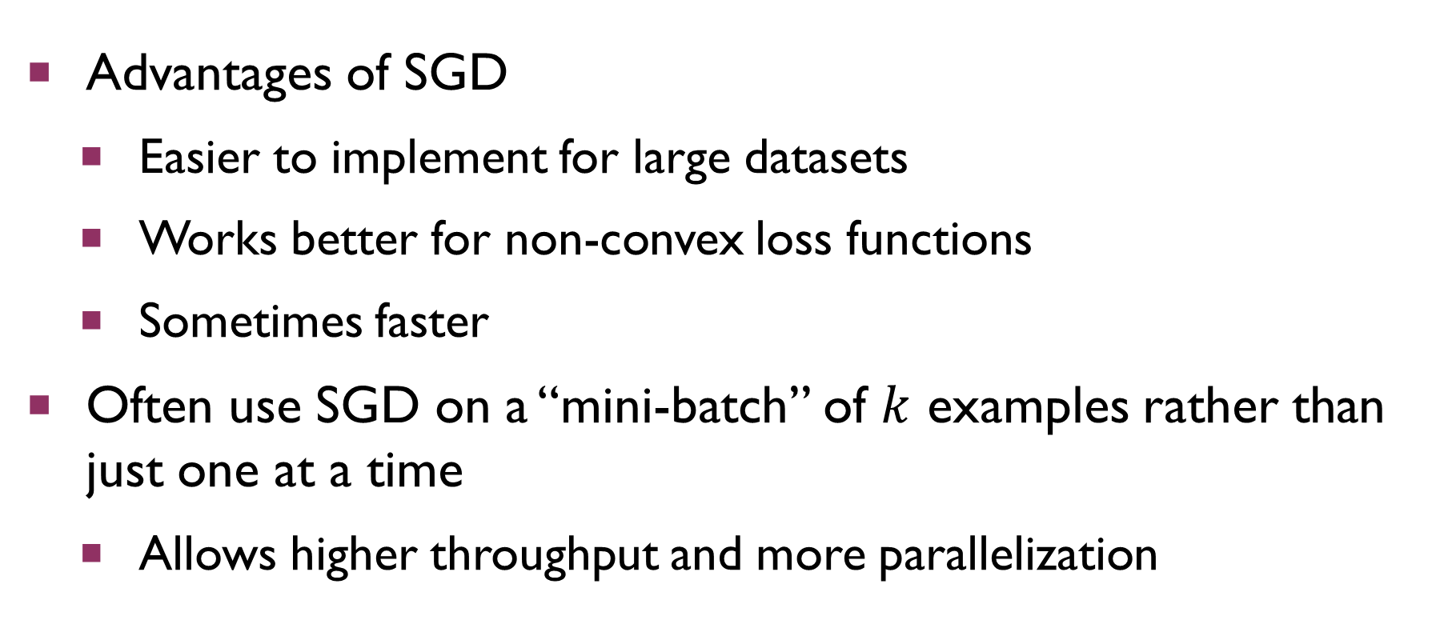
Stochastic Gradient Descent
Advantages of SGD
Easier to implement for large datasets
Works better for non-convex loss functions
Sometimes faster
Often use SGD on a “mini-batch” of $k$ examples rather than just one at a time
Allows higher throughput and more parallelization

Slide 23
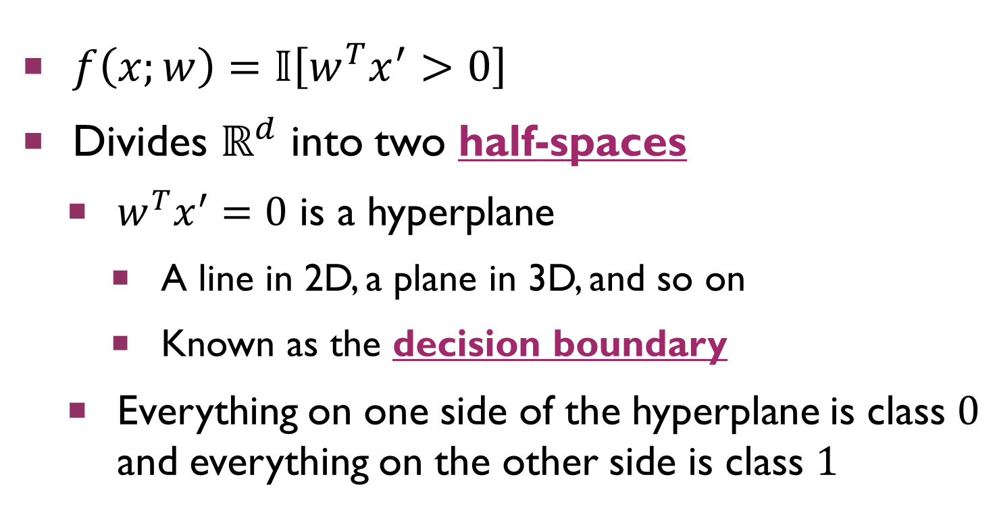
Binary Linear Classification
$f\left(x;w\right)=𝕀\left[w^{T}x^{′}>0\right]$
Divides $ℝ^{d}$ into two half-spaces
$w^{T}x^{′}=0$ is a hyperplane
A line in 2D, a plane in 3D, and so on
Known as the decision boundary
Everything on one side of the hyperplane is class $0$ and everything on the other side is class $1$

Slide 24
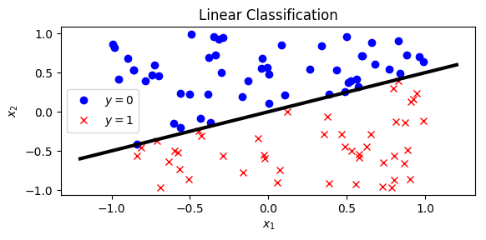
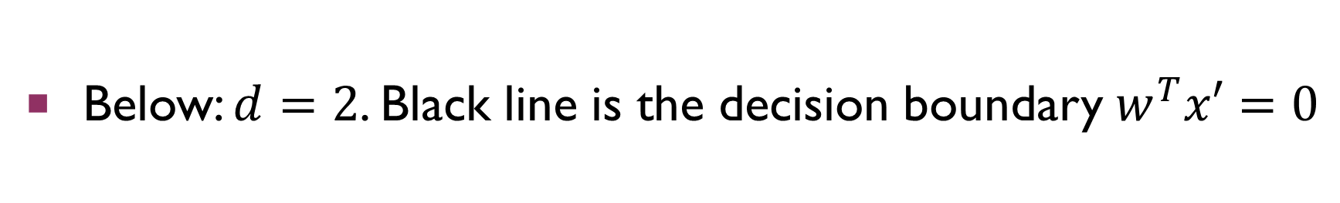
Binary Linear Classification
Below: $d=2$. Black line is the decision boundary $w^{T}x′=0$
Notes:
Consider mentioning Johnson-Lindenstrass Theorem + picture (one slide) – to

Slide 25
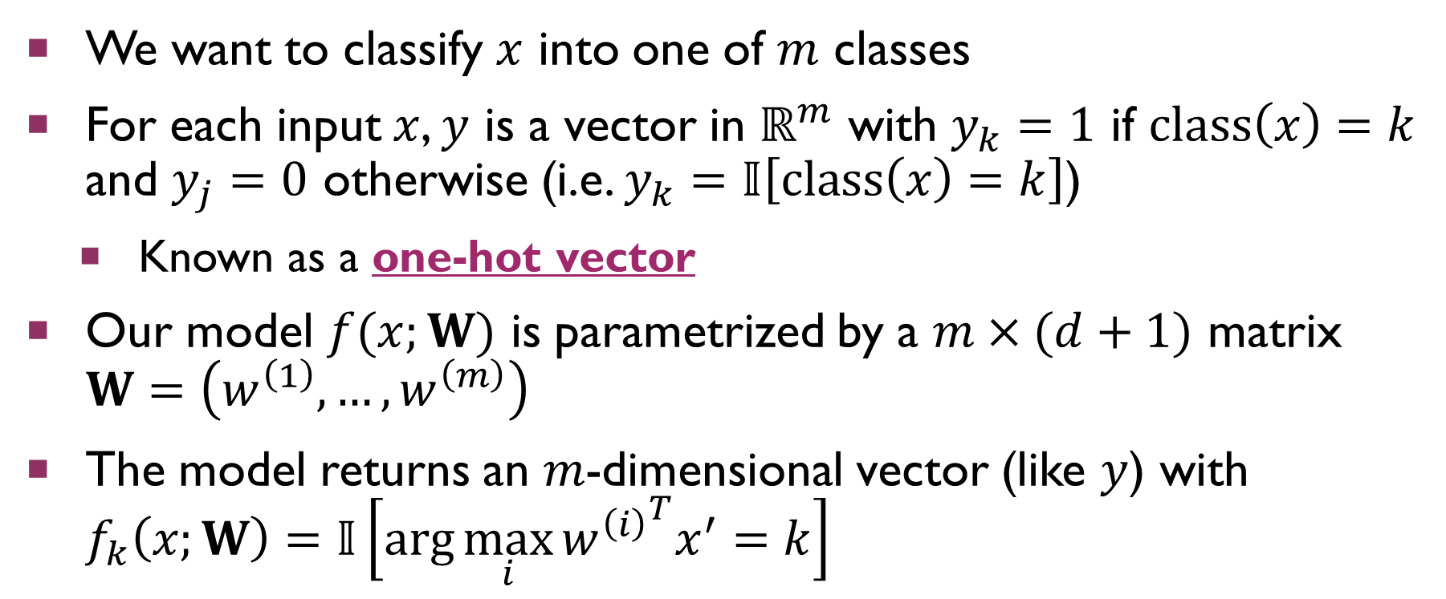
Multi-Class Generalization
We want to classify $x$ into one of $m$ classes
For each input $x$, $y$ is a vector in $ℝ^{m}$ with $y_{k}=1$ if $class\left(x\right)=k$ and $y_{j}=0$ otherwise (i.e. $y_{k}=𝕀\left[class\left(x\right)=k\right]$)
Known as a one-hot vector
Our model $f(x;W)$ is parametrized by a $m×(d+1)$ matrix $W=\left(w^{\left(1\right)},…,w^{\left(m\right)}\right)$
The model returns an $m$-dimensional vector (like $y$) with $f_{k}\left(x;W\right)=𝕀\left[\arg{\max_{i}{{w^{\left(i\right)}}^{T}x^{′}}}=k\right]$
Notes:
One hot vectors: say we have $m=4$ classes. Then, $class\left(x\right)=1$ corresponds to $y=\left(1, 0, 0, 0\right)$, $class\left(x\right)=2$ has $y=(0, 1, 0, 0)$, $class\left(x\right)=3$ has $y=(0, 0, 1, 0)$, and $class\left(x\right)=4$ has $y=(0, 0, 1, 0)$.

Slide 26
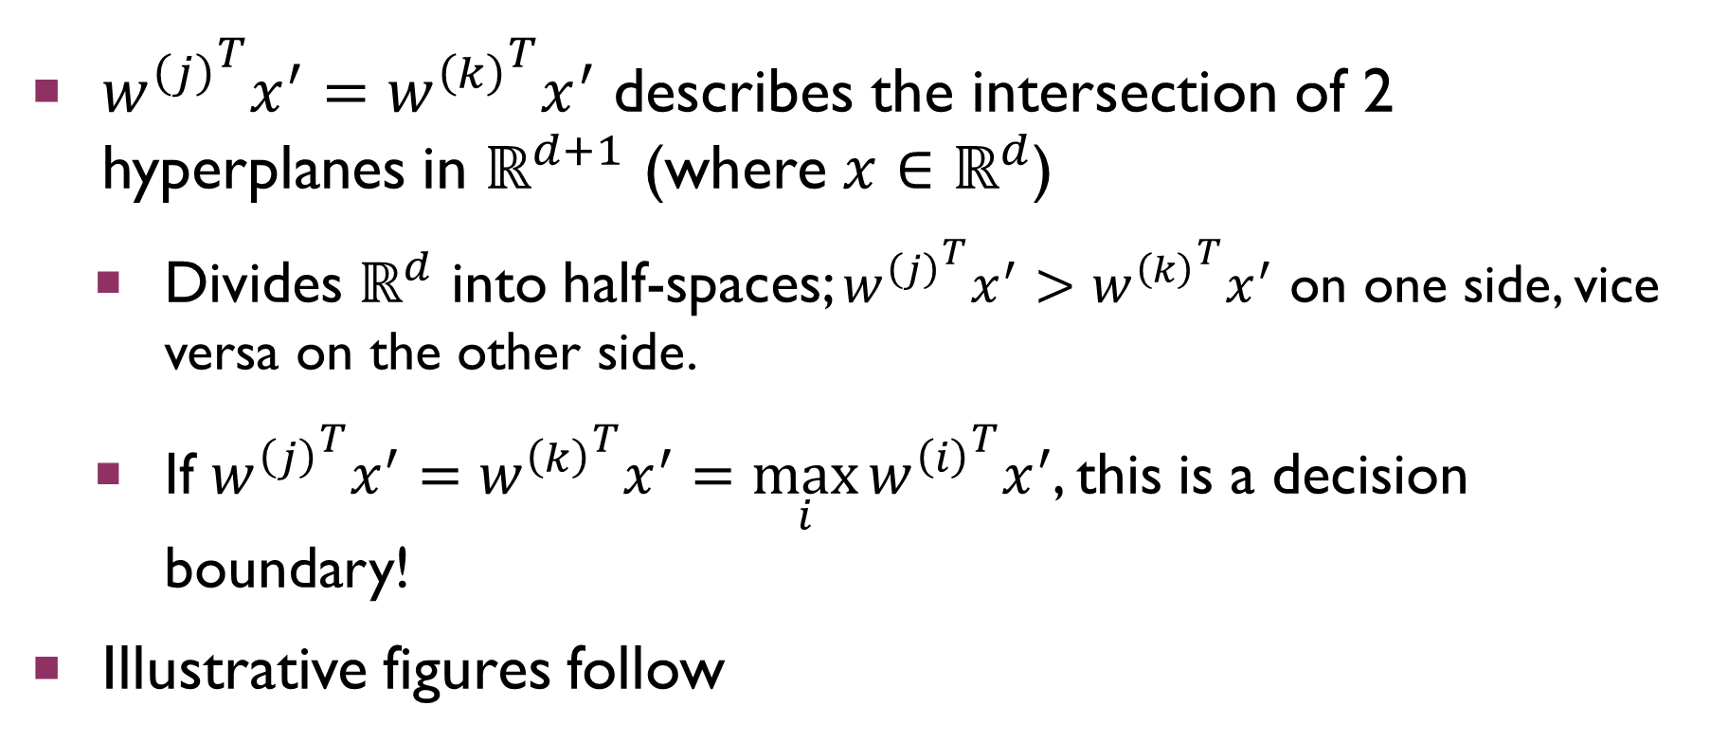
Multi-Class Generalization
${w^{\left(j\right)}}^{T}x^{′}={w^{\left(k\right)}}^{T}x^{′}$ describes the intersection of 2 hyperplanes in $ℝ^{d+1}$ (where $x∈ℝ^{d}$)
Divides $ℝ^{d}$ into half-spaces; ${w^{\left(j\right)}}^{T}x^{′}>{w^{\left(k\right)}}^{T}x^{′}$ on one side, vice versa on the other side.
If ${w^{\left(j\right)}}^{T}x^{′}={w^{\left(k\right)}}^{T}x^{′}=\max_{i}{{w^{\left(i\right)}}^{T}x^{′}}$, this is a decision boundary!
Illustrative figures follow

Slide 27
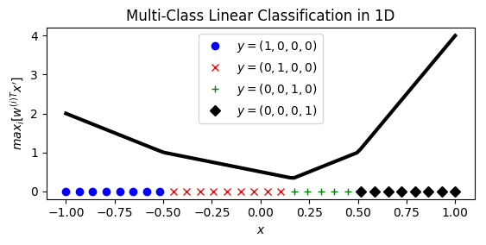

Multi-Class Generalization
Below: $d=1$, $m=4$. $\max_{i}{{w^{\left(i\right)}}^{T}x^{′}}$ is graphed.

Slide 28
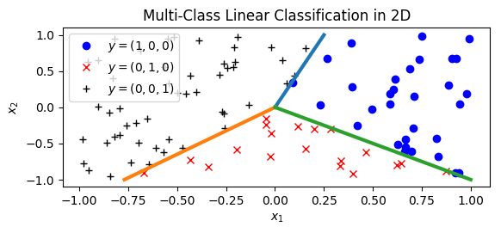
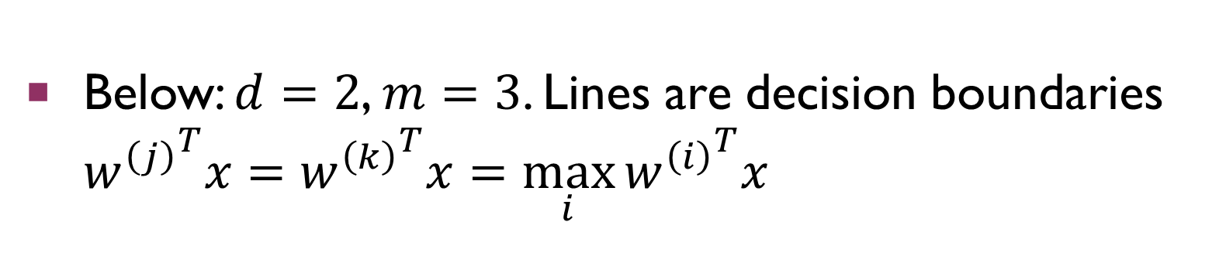
Multi-Class Generalization
Below: $d=2$, $m=3$. Lines are decision boundaries ${w^{\left(j\right)}}^{T}x={w^{\left(k\right)}}^{T}x=\max_{i}{{w^{\left(i\right)}}^{T}x}$

Slide 29
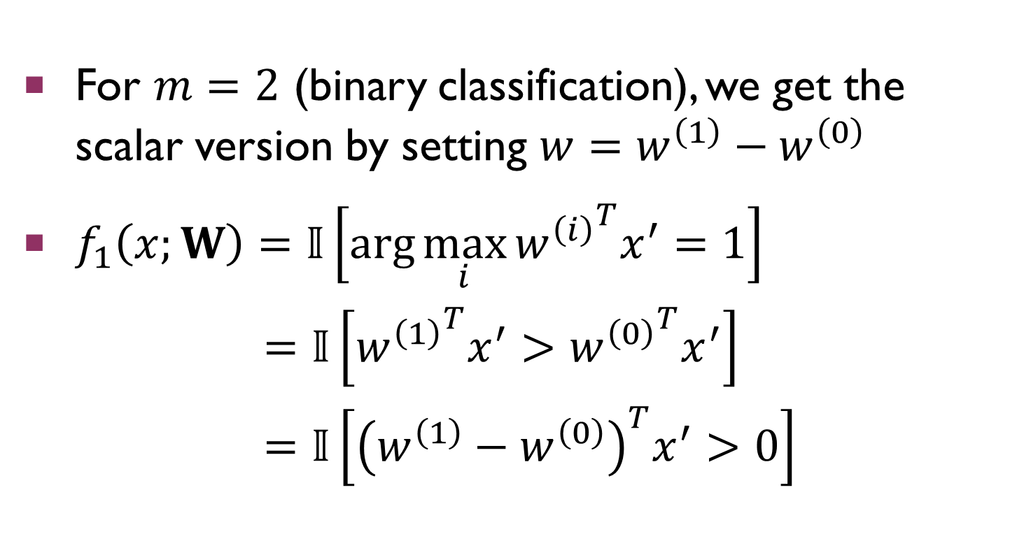
Multi-Class Generalization
For $m=2$ (binary classification), we get the scalar version by setting $w=w^{\left(1\right)}−w^{\left(0\right)}$
$f_{1}\left(x;W\right)=𝕀\left[\arg{\max_{i}{{w^{\left(i\right)}}^{T}x^{′}}}=1\right]$ $=𝕀\left[{w^{\left(1\right)}}^{T}x^{′}>{w^{\left(0\right)}}^{T}x^{′}\right]$ $=𝕀\left[{\left(w^{\left(1\right)}−w^{\left(0\right)}\right)}^{T}x^{′}>0\right]$

Slide 30
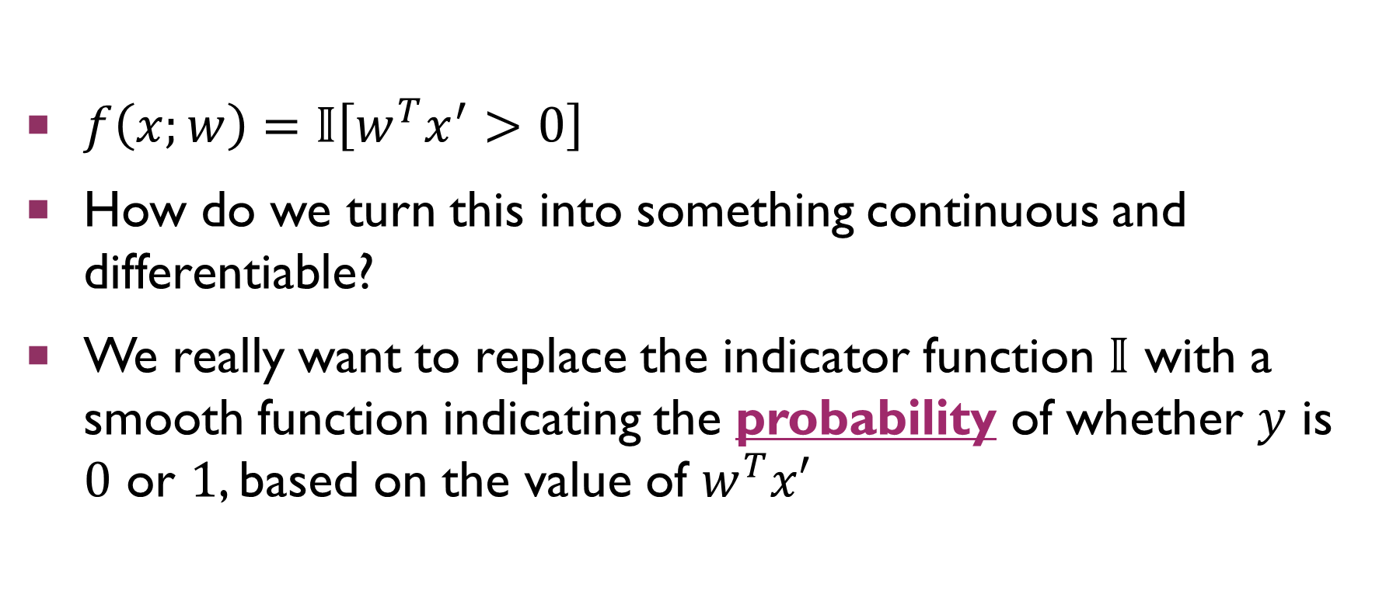
Fitting a Linear Classifier
$f\left(x;w\right)=𝕀\left[w^{T}x^{′}>0\right]$
How do we turn this into something continuous and differentiable?
We really want to replace the indicator function $𝕀$ with a smooth function indicating the probability of whether $y$ is $0$ or $1$, based on the value of $w^{T}x′$

Slide 31
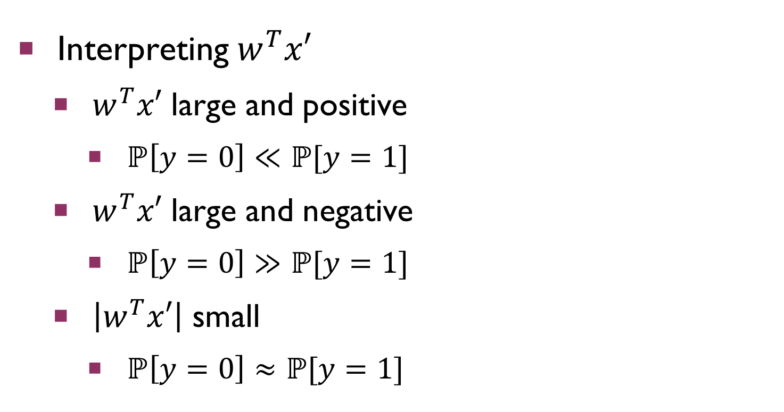
Probabilistic Interpretation
Interpreting $w^{T}x′$
$w^{T}x′$ large and positive
$ℙ\left[y=0\right]≪ℙ[y=1]$
$w^{T}x′$ large and negative
$ℙ\left[y=0\right]≫ℙ[y=1]$
$\left|w^{T}x′\right|$ small
$ℙ\left[y=0\right]≈ℙ[y=1]$

Slide 32
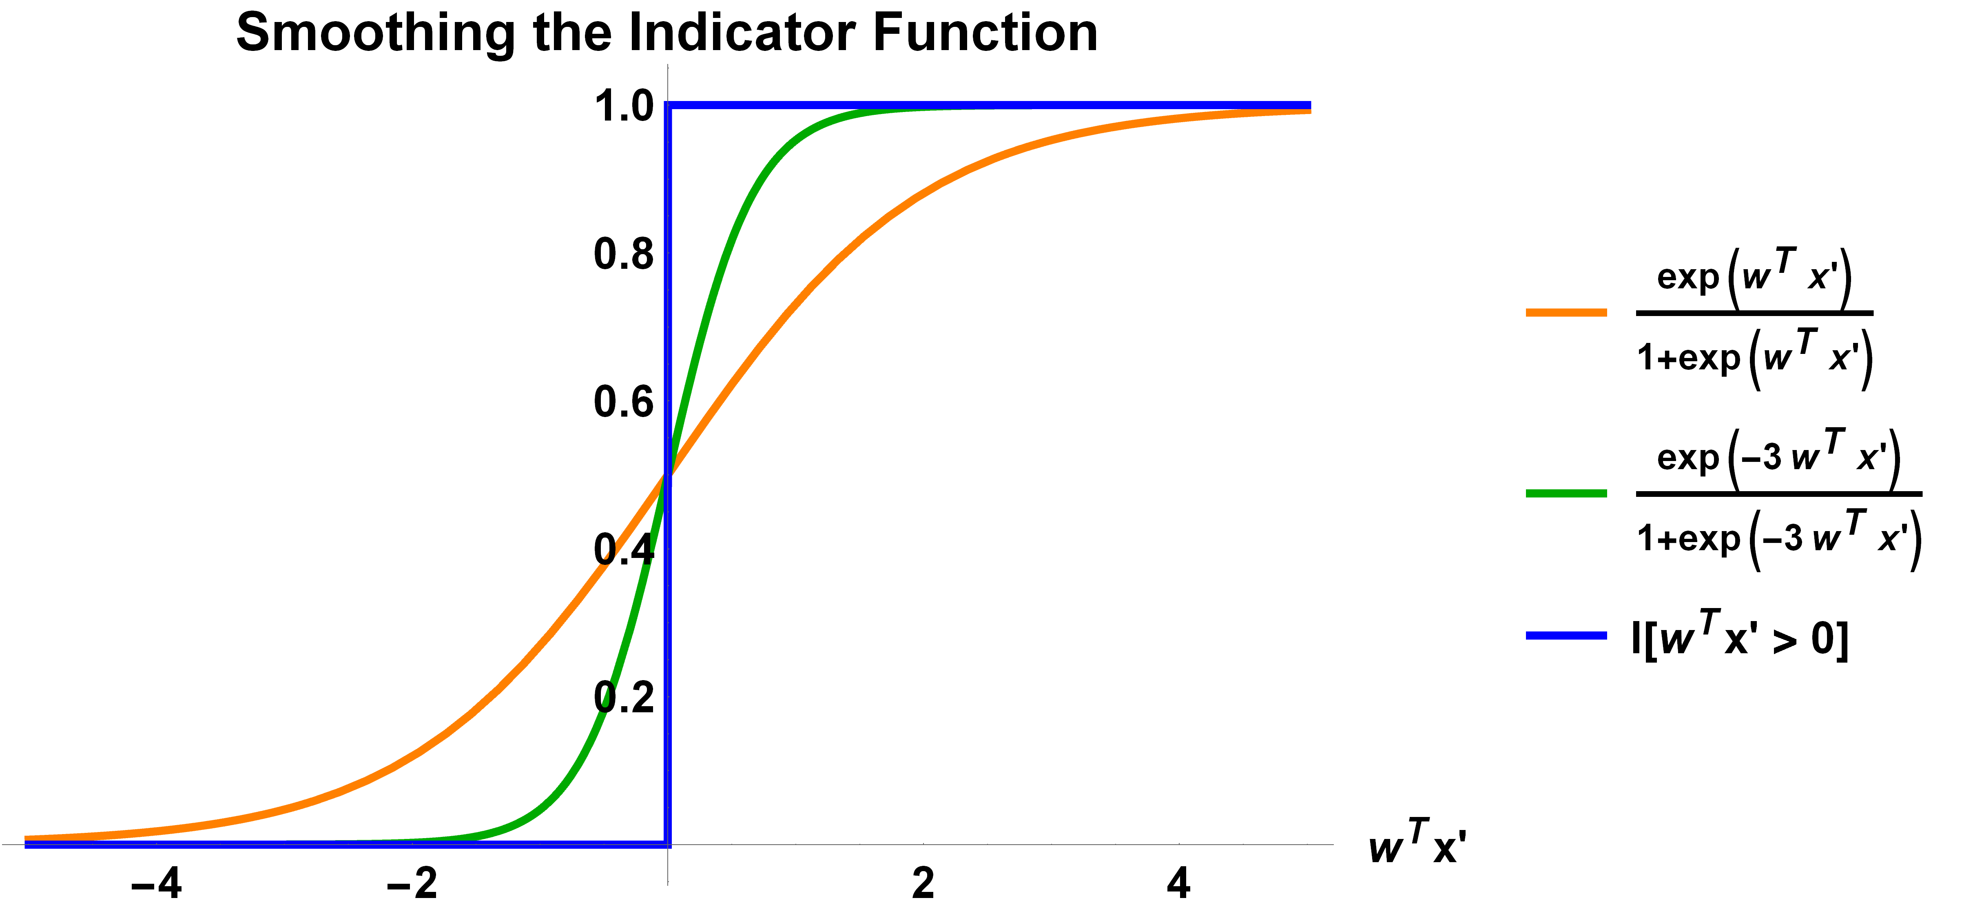
Probabilistic Interpretation

Slide 33
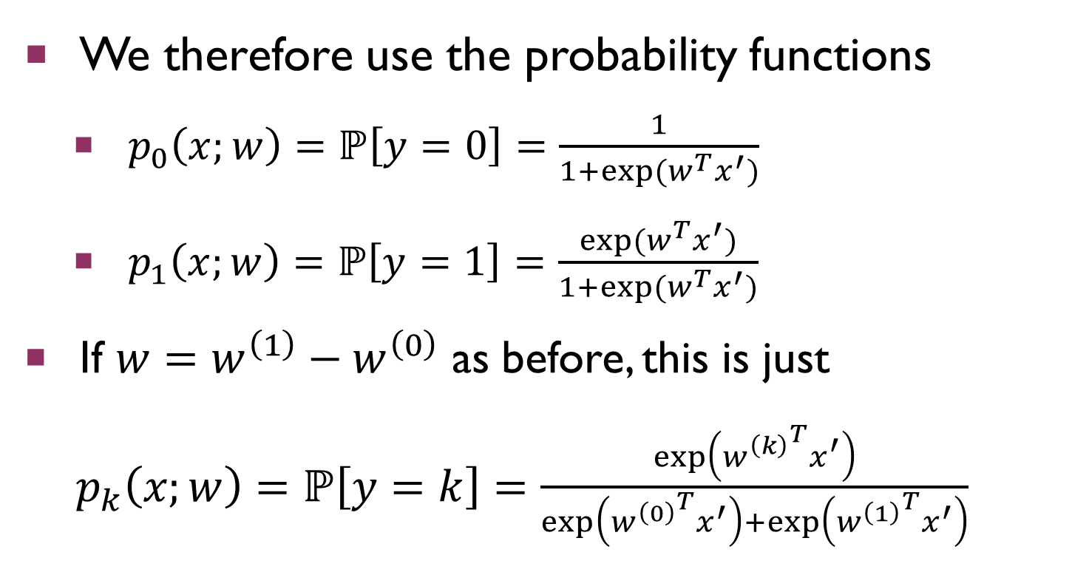
Probabilistic Interpretation
We therefore use the probability functions
$p_{0}\left(x;w\right)=ℙ\left[y=0\right]=\frac{1}{1+exp⁡(w^{T}x^{′})}$
$p_{1}\left(x;w\right)=ℙ\left[y=1\right]=\frac{exp⁡(w^{T}x^{′})}{1+exp⁡(w^{T}x^{′})}$
If $w=w^{\left(1\right)}−w^{\left(0\right)}$ as before, this is just
$p_{k}\left(x;w\right)=ℙ\left[y=k\right]=\frac{\exp\left({w^{\left(k\right)}}^{T}x^{′}\right)}{\exp\left({w^{\left(0\right)}}^{T}x^{′}\right)+\exp\left({w^{\left(1\right)}}^{T}x^{′}\right)}$
Notes:
If you don’t see why the last step is true, just multiply each of the probability functions by $exp\left({w^{\left(0\right)}}^{T}x\right)/exp\left({w^{\left(0\right)}}^{T}x\right)$.

Slide 34
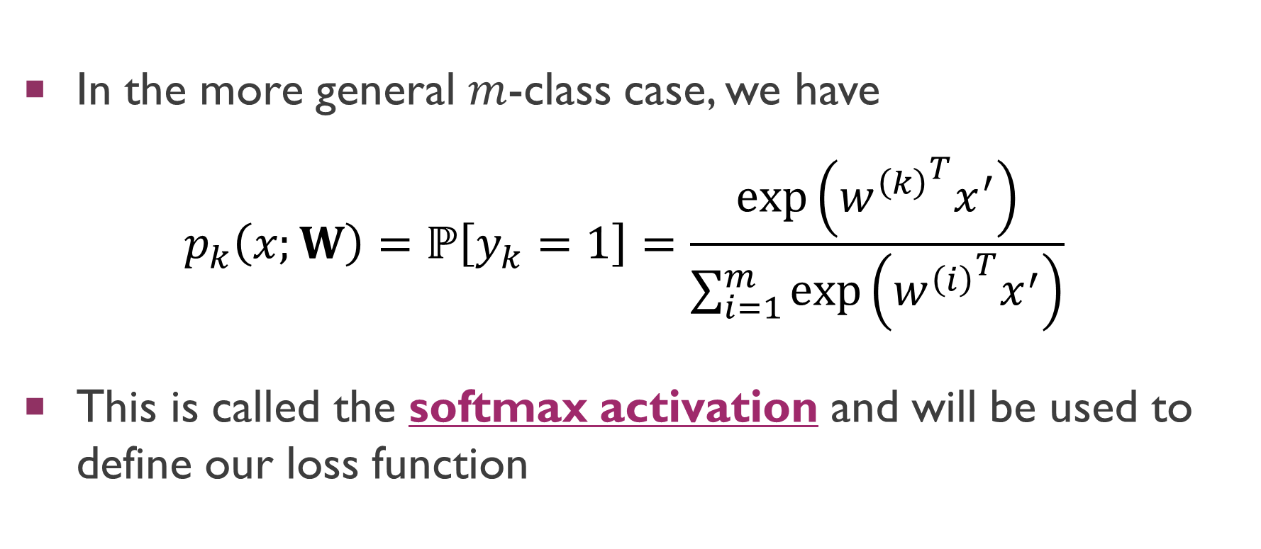
Probabilistic Interpretation
In the more general $m$-class case, we have
$$p_{k}\left(x;W\right)=ℙ\left[y_{k}=1\right]=\frac{\exp\left({w^{\left(k\right)}}^{T}x^{′}\right)}{\sum_{i=1}^{m}{\exp\left({w^{\left(i\right)}}^{T}x^{′}\right)}}$$
This is called the softmax activation and will be used to define our loss function

Slide 35
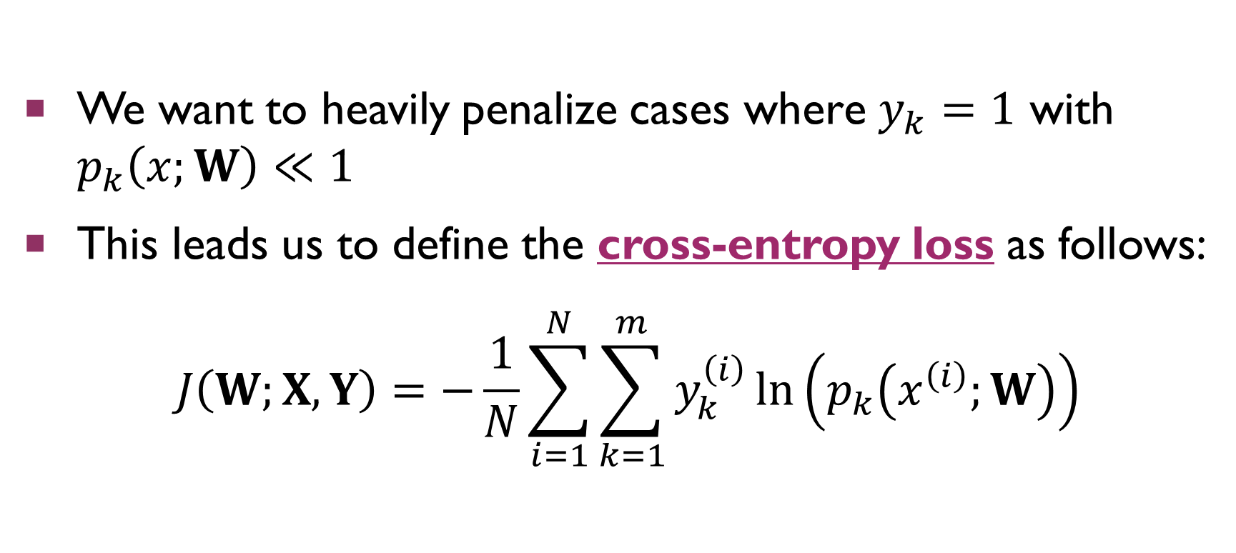
The Cross-Entropy Loss
We want to heavily penalize cases where $y_{k}=1$ with $p_{k}\left(x;W\right)≪1$
This leads us to define the cross-entropy loss as follows:
$$J\left(W;X,Y\right)=−\frac{1}{N}\sum_{i=1}^{N}{\sum_{k=1}^{m}{y_{k}^{\left(i\right)}\ln\left(p_{k}\left(x^{\left(i\right)};W\right)\right)}}$$
Notes:
For each $\left(x^{\left(i\right)},y^{\left(i\right)}\right)$ pair, multiplying by $y_{k}^{\left(i\right)}$ in the inner sum extracts $ln\left(p_{k}\left(x^{\left(i\right)};W\right)\right)$ only for the TRUE class $k$. Thus, we ONLY penalize cases where $y_{k}=1$ and $p_{k}\left(x;W\right)≪1$, and not cases where $y_{j}=0$ and $1−p_{j}\left(x;W\right)≪1$. This is still okay because $p(x;W)$ defines a probability distribution; if $1−p_{j}\left(x;W\right)≪1$ for any $j$, then we MUST have $p_{i}\left(x;W\right)≪1$ for all $i≠j$, including the $i$ for which $y_{i}=1$. This is just an intuitive treatment of the cross-entropy! It has formal foundations in information theory, but that’s beyond the scope of this class.

Slide 36
Minimizing Cross-Entropy
As with mean-squared error, the cross-entropy loss is convex and differentiable ☺
That means that we can use gradient descent to converge to a global minimum!
This global minimum defines the best possible linear classifier with respect to the cross-entropy loss and the data set given

Slide 37
Summary
Basic process of constructing a machine learning model
Choose an analytically well-behaved loss function that represents some notion of error for your task
Use gradient descent to choose model parameters that minimize that loss function for your data set
Examples: linear regression and mean squared error, linear classification and cross-entropy

Slide 38
Next Time
Gradient of the cross-entropy loss
Neural networks
Backpropagation algorithm for gradient descent

